Slide 1
Master and Commander
Joshua 5:13-15
Preached by Dr. Gordon Penfold at Crossroads International Church Singapore • cicfamily.com Uploaded by Dr. Rick Griffith • Singapore Bible College Files in many languages for free download at BibleStudyDownloads.org

Slide 2
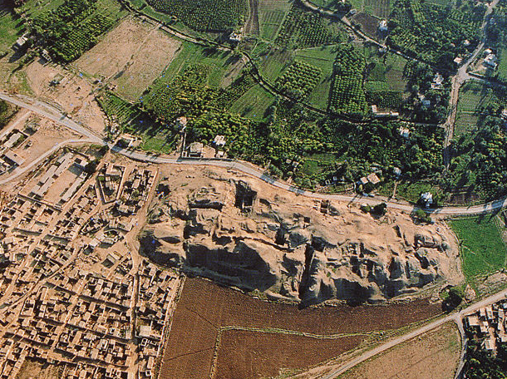
Tell Sultan

Slide 3
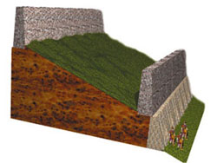
2nd Brick
Rampart
15 m.
2 m. thick,
5-6 m. high
3-4 m. high
Tell Sultan—Schematic cross-section diagram of the fortification system at Jericho based on Kenyon's west trench.—AiG

Slide 4
1. The Challenge Joshua 5:13a
2. The “Challenge” Joshua 5:13b
3. The Commander Joshua 5:14a

Slide 5
So he answered and said to me: "This is the word of the LORD to Zerubbabel: 'Not by might nor by power, but by My Spirit,' says the LORD of hosts." Zechariah 4:6

Slide 6
³For though we walk in the flesh, we do not war according to the flesh. ⁴For the weapons of our warfare are not carnal but mighty in God for pulling down strongholds, ⁵casting down arguments and every high thing that exalts itself against the knowledge of God, bringing every thought into captivity to the obedience of Christ. 2 Cor 4:3-5

Slide 7
Both read the same Bible and pray to the same God, and each invokes His aid against the other. It may seem strange that any men should dare to ask a just God's assistance in wringing their bread from the sweat of other men's faces, but let us judge not, that we be not judged. The prayers of both could not be answered. That of neither has been answered fully. The Almighty has His own purposes. —Abraham Lincoln, second inaugural address, 1865

Slide 8
¹²Now I say this, that each of you says, "I am of Paul," or "I am of Apollos," or "I am of Cephas," or "I am of Christ." ¹³Is Christ divided? Was Paul crucified for you? Or were you baptized in the name of Paul? 1 Corinthians 1:12-13

Slide 9
2 Kings 6:8-17
Matthew 26:51-53

Slide 10
4. The Command Joshua 5:14b-15

Slide 11
Responding to the Word of God

Slide 12
Master and Commander
Whose side are you on?
Joshua 5:13-15

Slide 13
Black

Slide 14
OT Preaching link at BibleStudyDownloads.org
Get this presentation and script for free!
Notes:
OT Preaching (op)

